Slide 1
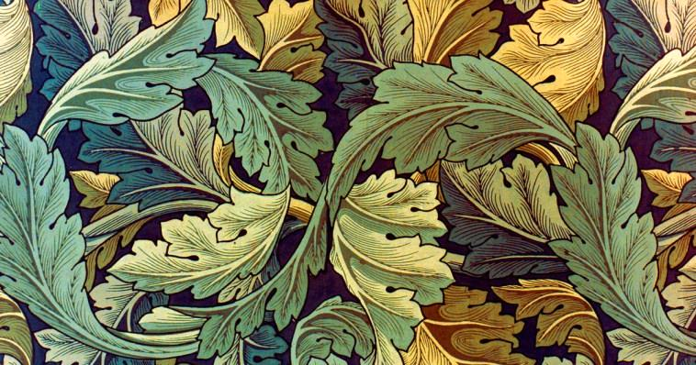
Sessions 3/4
Day 3, Activity 1,2,3
Notes:
Day 3, Activity 1,2,3

Slide 2
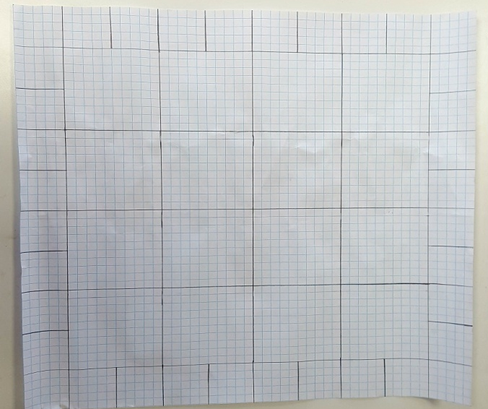
Creating a design template
Draw a grid 55cm x 55cm on large sheet of 1cm squared paper.
Draw a border of 5cm and split these up into 5cm squares.
Draw an internal square of 40cm.
Split this up into 16 x 10cm square boxes.
By Sba Shaikh for William Morris Gallery 2020

Slide 3
Planning, designing and printing cushion covers
Use the photocopies of your blocks, to plan you design
- things to consider rotation, refection transformation.
2. Each group will be allocated 3 colours to work with. You will not be allowed to swap or change the colours. You need to discuss how these 3 colours are going to feature in your design. Are you going to use all 3 colours in both the border and the centre of the design or are you going to use different colours for the different areas?
3. Create your cushion cover design.

Slide 4
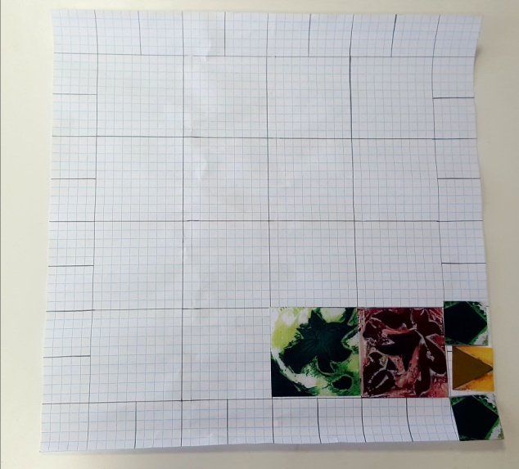
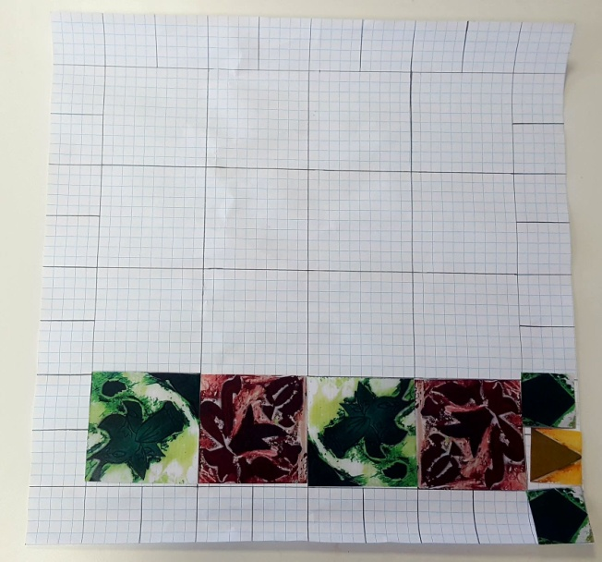
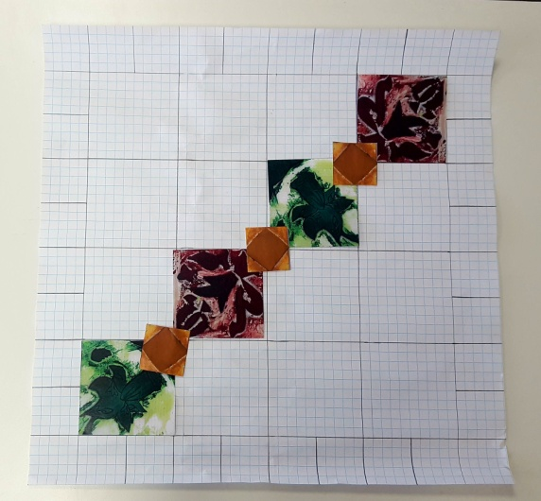
Example planning using colour photocopies of blocks to build up the design.
By Sba Shaikh for William Morris Gallery 2020
Notes:
Day 4 Am, activity 1,2,3
Day 4 Pm activity 1

Slide 5
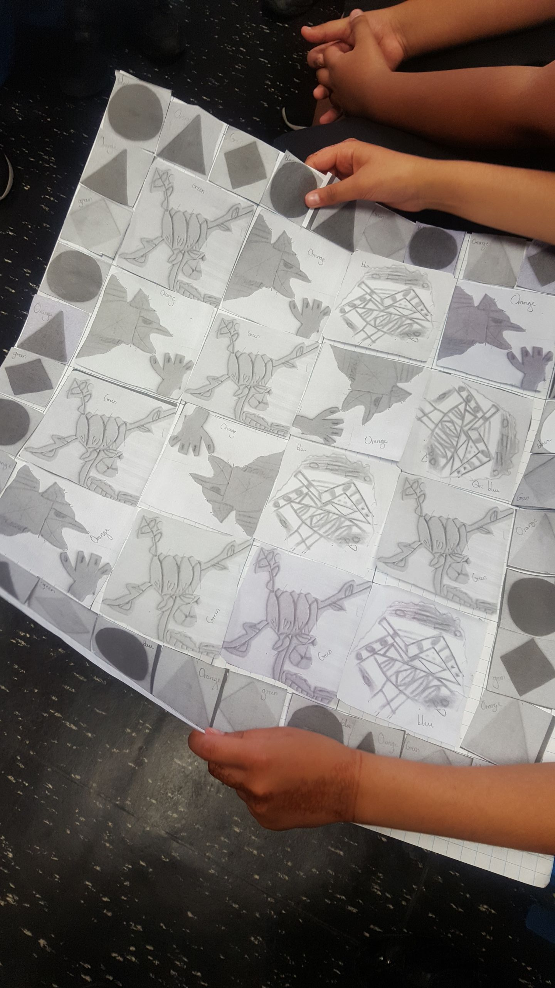
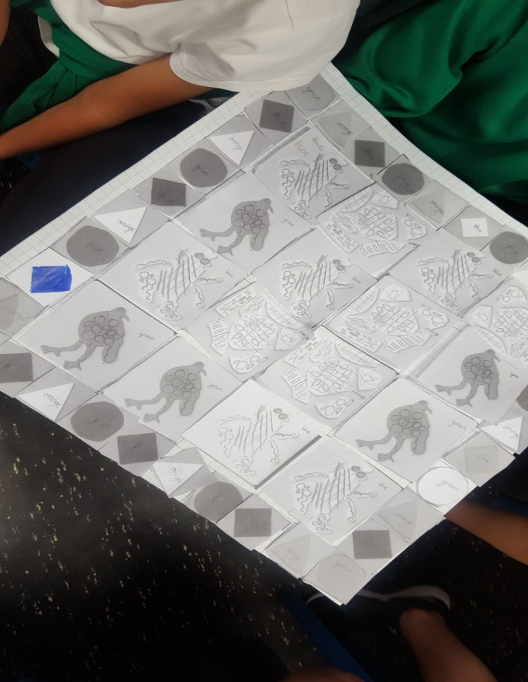
Examples of design layout planning by year 5 students from Greenleaf Primary School, Walthamstow.
By Sba Shaikh for William Morris Gallery 2020

Slide 6
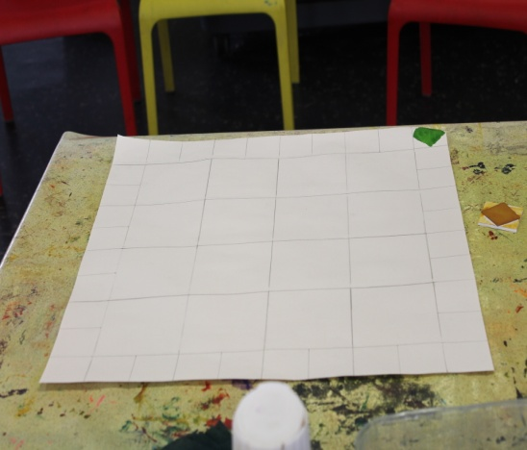
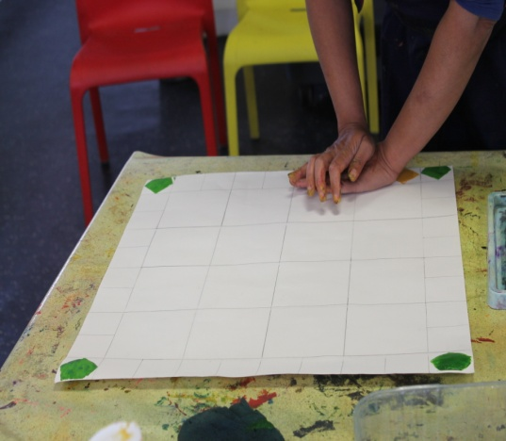
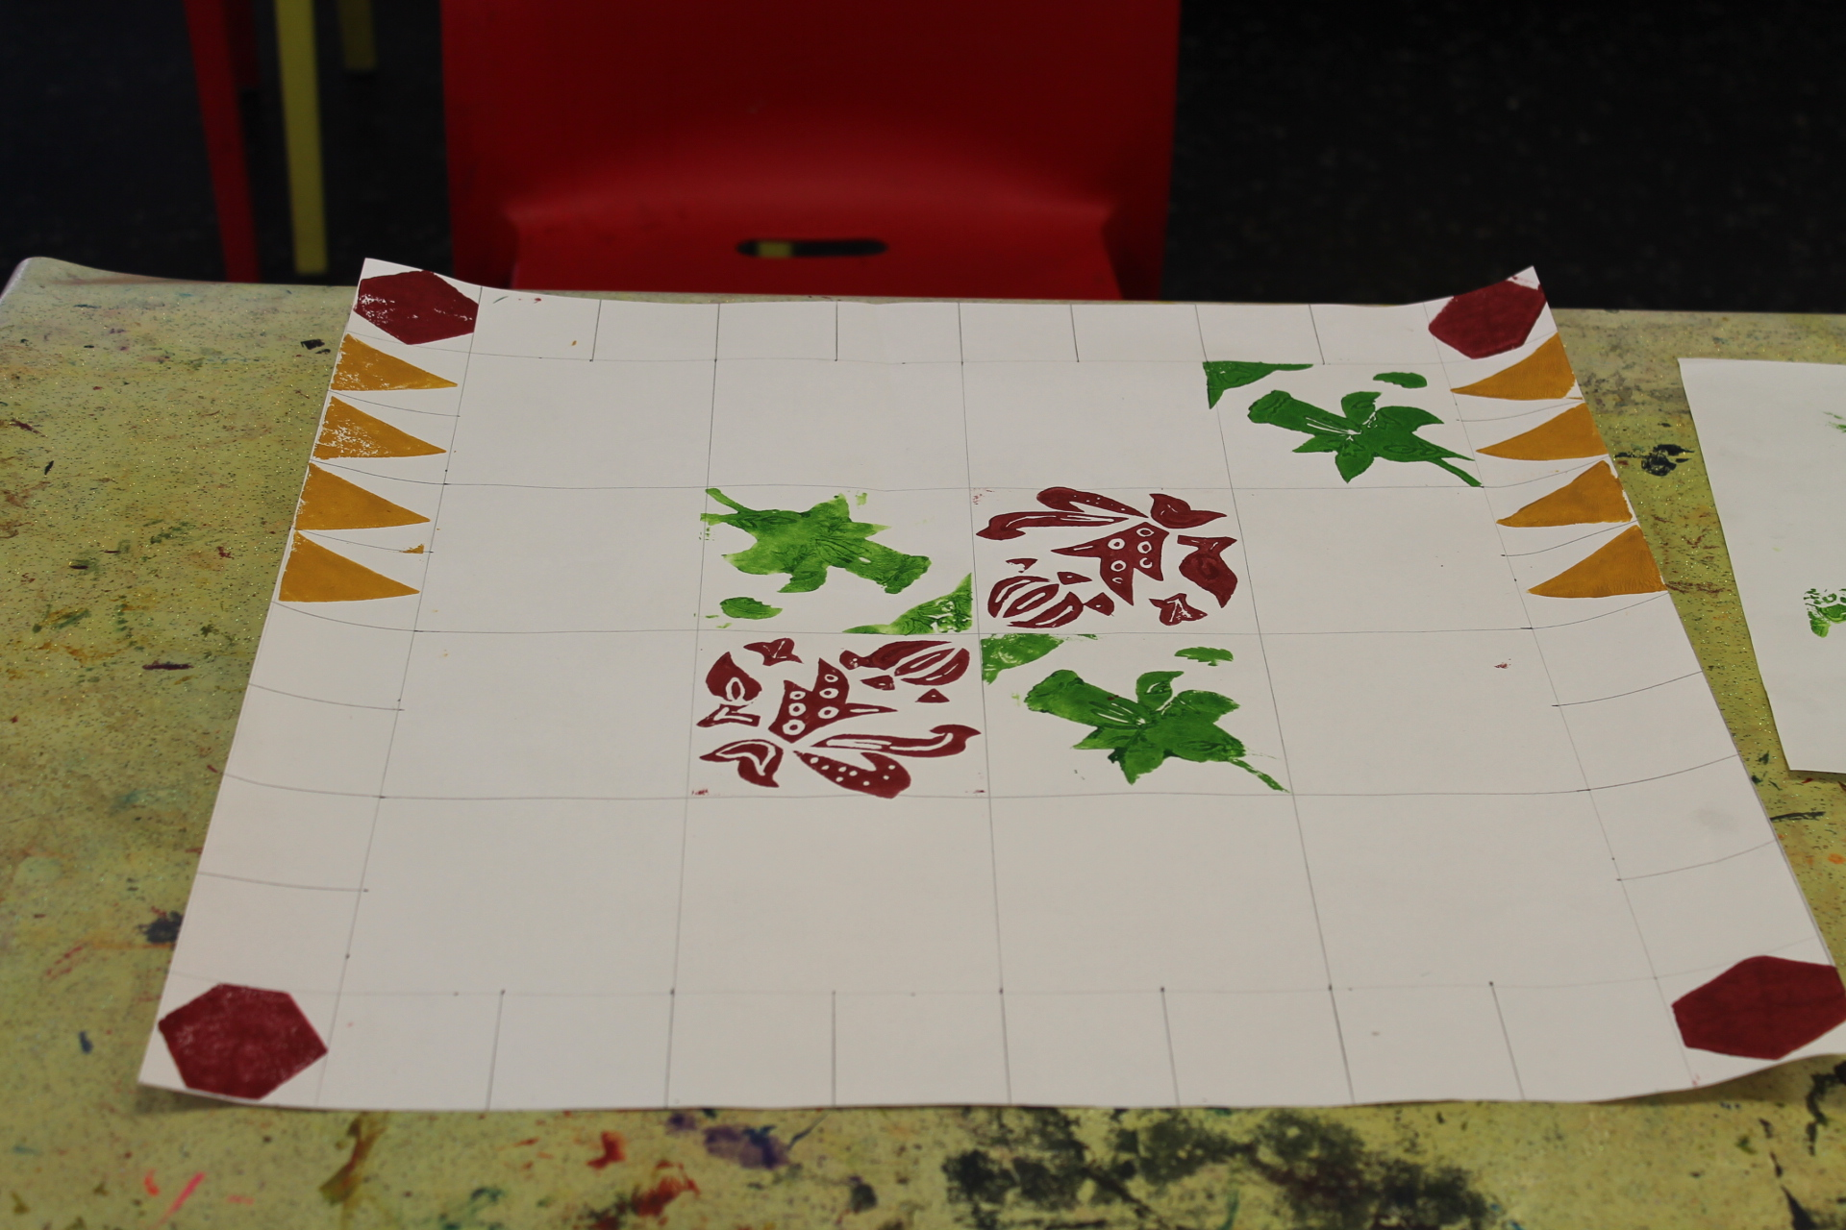
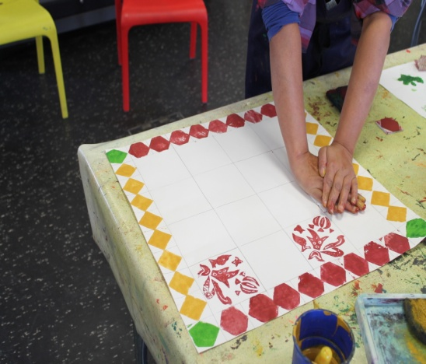
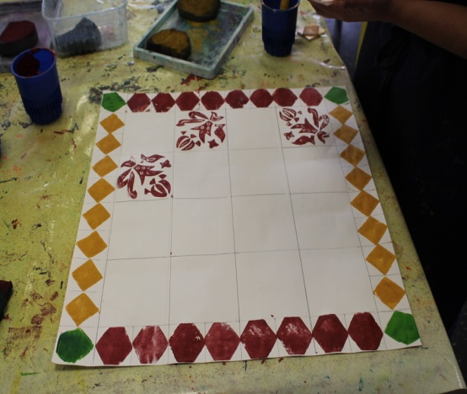
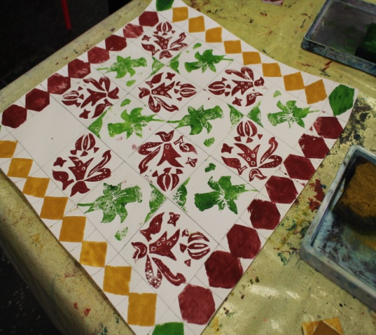
Print the design on paper before moving on to textile.
By Sba Shaikh for William Morris Gallery 2020

Slide 7
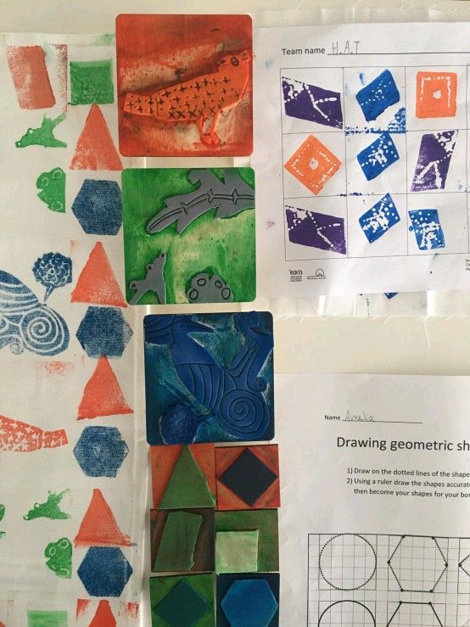
Examples of work by year 5 students from Greenleaf Primary School, Walthamstow..
By Sba Shaikh for William Morris Gallery 2020

Slide 8
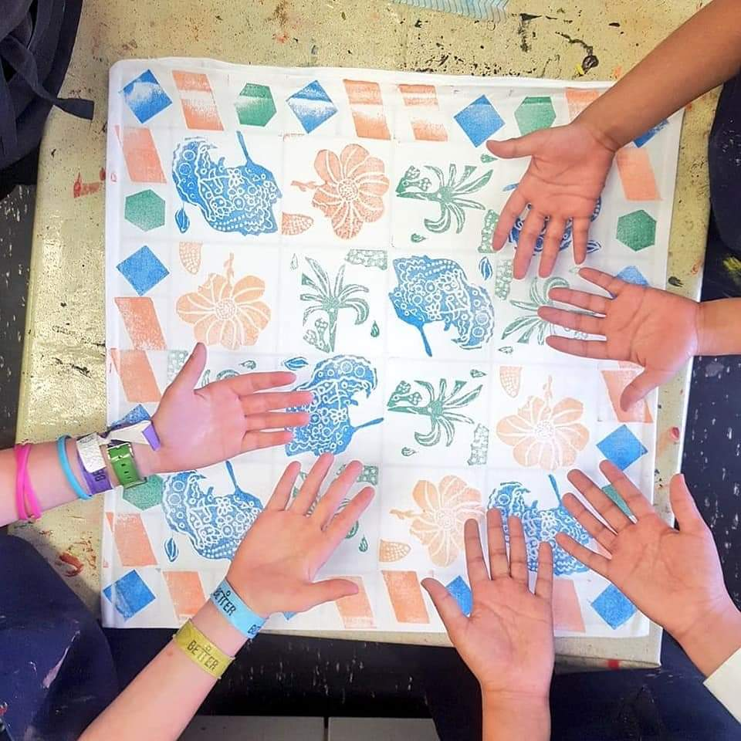
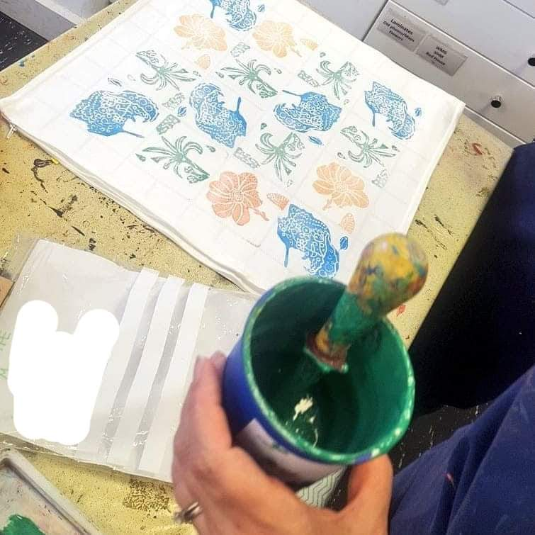
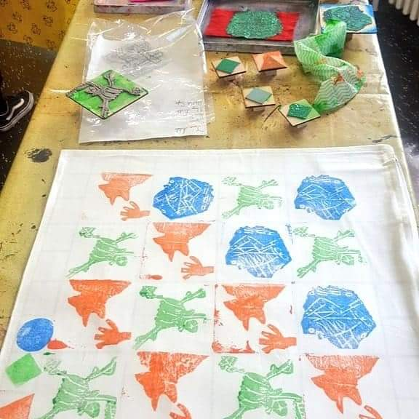
By Sba Shaikh William for Morris Gallery 2020

Slide 9
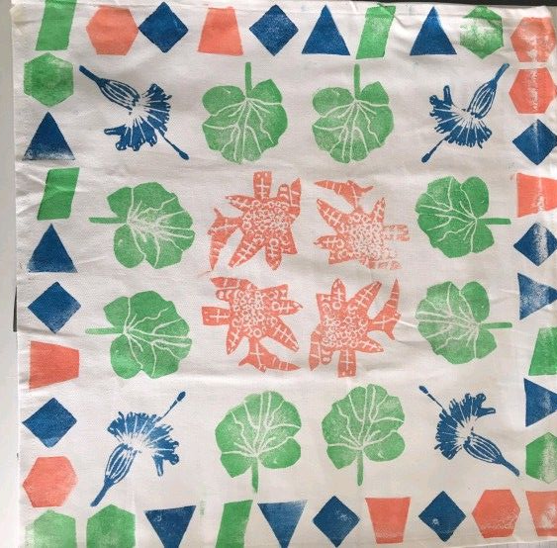
Final printed cushion by one of the teams from Green leaf primary.
By Sba Shaikh William for Morris Gallery 2020

